Slide 2
The Problem is Massive
Respiratory Muscle Weakness (RMW) – MASSIVE
• Affects 60 Million people in the US
• If not treated — patient continues to weaken
• Drugs & Expensive Treatments — only mask the problem

Slide 3
How the Problem Affects Us
Weak respiratory muscles result in
shortness of breath, reduced
stamina, poor sleep and the
inability to expectorate – especially
dangerous for the elderly, those
with asthma, pulmonary rehab,
and COPD.

Slide 4
Alternatives
– Exercise (not always possible – old, brittle, hips, surgery)
– Other respiratory therapy devices
– Unfortunately, many respiratory devices…
• Are single purpose
• Are hard to use
• Difficult to adjust
• Or they won’t work if you have a weak mouth gripe or lip seal
• Not using modern apps to guide and help patients

Slide 5
The Big Question
So, how do you strengthen your respiratory muscles with a
device that is easy to understand, adjust, that doesn’t require
strong jaw gripe and doesn’t require you to purchase multiple
devices?
Wouldn’t it also be a plus if it would also include an interactive
mobile app that shows progress?
Perhaps you should consider…

Slide 6
Introducing…

Slide 7
Credibility
– World’s First and Patented Personal
Respiratory Therapy
• Over 38 years of working clinical success
– Over 1 million sold!
– Largest repository of clinical
evidence with over 100 articles
– Don’t accept substitutes (knock-offs)

Slide 8
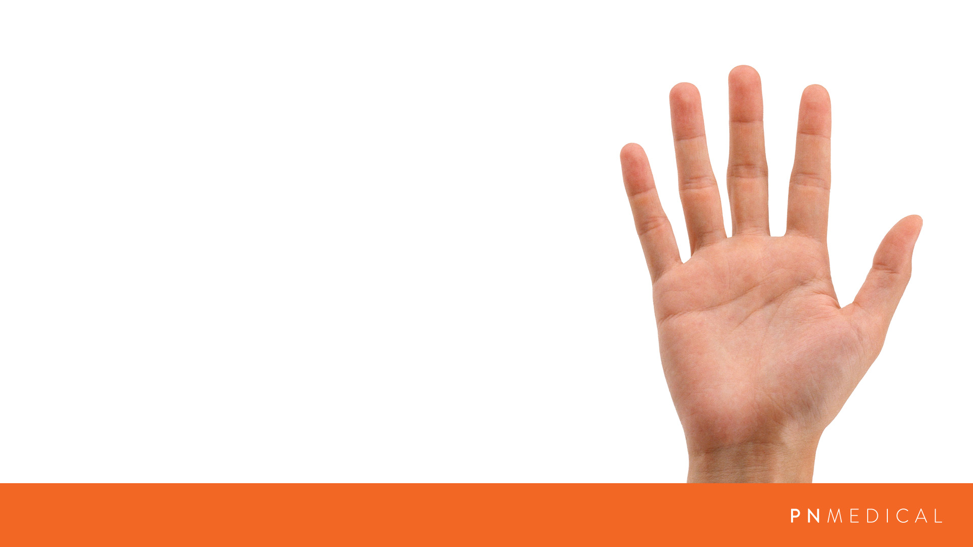
The BEST Solution
Five main reasons to consider
1. Only medical device that strengthens
BOTH Inhale and Exhale muscles
2. The EASIEST to Use
3. Industry’s MOST Comfortable
4. 1st & ONLY Respiratory Muscle
Therapy Coaching App
5. Price Performance LEADER

Slide 9
1. Strengthens BOTH Inhale
& Exhale Muscles
– Includes BOTH inhale and Exhale Resistive Pressure
• IMT and EMT
– Benefits
• Strengthens vocal, abdominal, diaphragm
and respiratory muscles
• Decreases shortness of breath
• Helps cough production
• Enhances stamina
• Safe Swallowing, Sleep apnea, Asthma, COPD & more

Slide 10
2. Easiest to Use (by-the-numbers)
– Large numbered dials
– Grip Ridges
• Easy to turn by hand or palm (weak grip strength)
– Easy for clinicians to prescribe
– “Set to 3”
• Instead of “Turn 25%”
– Patients progress by the numbers

Slide 11
3. Industry’s MOST Comfortable
– Only patented medical device with…
• Flanged ergonomic mouthpiece
• Natural Grip Points
• No claustrophobic face mask or scary
mouthpiece

Slide 12
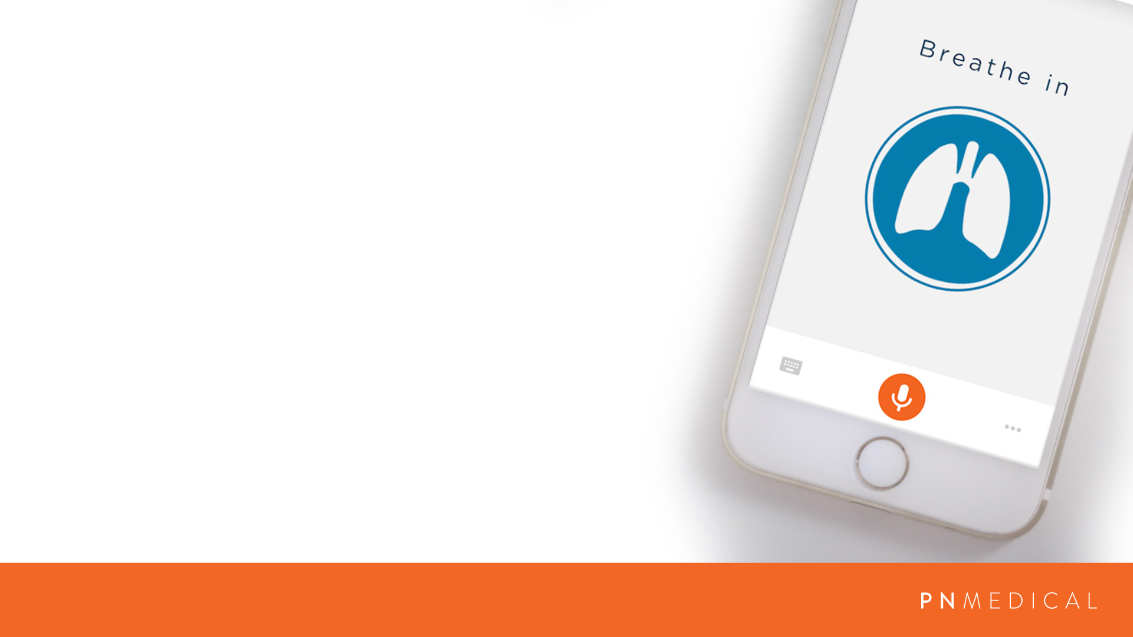
4. ONLY Respiratory Device with App
– Mobile app for IOS and Android watch, phone or tablet smart device
• With manual or voice input that guides breathing, perfect for arthritis or stroke
– Alerts if you missed a session
– Captures baseline, daily and weekly
assessments and progress
– Connects directly to your clinician who establishes and monitors your routine

Slide 13
5. Price Performance LEADER
– Includes two therapies in a single medical device
• Cuts costs in half
– Free mobile app, professional training videos, and live clinician support
– One of the industry’s lowest SRP’s
• Retail ready
– The undisputed best value!

Slide 14
How Does It Compare?
– World’s first patented device
– Only 2-1 device with 38 years of
working clinical knowledge
– Other devices - either a knock off or
not as intuitive or as easy-to-use
– Easy = higher patient adherence

Slide 15
How Does it Compare?
1. Only medical device that strengthens
BOTH Inhale and Exhale muscles
2. The EASIEST to Use
3. Industry’s MOST Comfortable
4. 1st & ONLY Respiratory Muscle
Therapy Coaching App
5. Price Performance LEADER

Slide 16
Testimonials
“Diagnosed with lung cancer...The Breather taught me to inhale more deeply I can do almost everything I did before the surgeries.” “I had a stroke… The Breather taught me how to use my diaphragm to fill my lungs… I can now can walk a mile.” “Diagnosed with Parkinson’s… The Breather is simple and easy to use and has helped improve my strength and endurance. It has given me back my voice! I feel more confident. I can’t imagine living without this tool! I highly recommend it!

Slide 17
Picture This
– In just 5 minutes twice a day - strong respiratory muscles. High impact – drug free therapy
– No more shortness of breath, increased stamina, you’re sleeping MUCH better and a
cold doesn’t darn near kill you
– Life is good!

Slide 18
Next Steps
– PN Medical Order Now web page
– Become a reseller

Slide 19
Questions & Answers

